Slide 1
An Architecture for Creating Collaborative Semantically
Capable Scientific Data Sharing Infrastructures
Anuj R. Jaiswal, C. Lee Giles, Prasenjit Mitra, James Z. Wang
Presentation by Paulo Shakarian

Slide 2
Outline
Problem
Overall Goal
Contributions
Metadata
Implementation
Future Work
Comparison to SIBDATA Concept

Slide 3
Problem
Researchers often reference experimental results of their predecessors
However, the raw data of experimental results is often not readily available.
  Hence, results often cannot easily be re-used or combined with other experiments

Slide 4
Problem (cont.)
Large repositories (i.e. NASA, NOAA, etc.) do collect experimental data
  Often conform to global schema (which may cause some data to be lost)
  Or stored as flat-files (requiring custom-built query applications)
Also, data labels in experiments may differ (i.e. Temp. vs. Temperature vs. Celsius)

Slide 5
Overall Goal
Architecture for dissemination, sharing, querying, and searching of scientific data on the WWW
Schema not known a-priori
Approach relies on sufficient meta-data of two varieties:
  Data about the experiment (conditions, source, when uploaded, etc.)
  Semantics for columns/rows in experimental results (what they represent, what units, etc.)

Slide 6
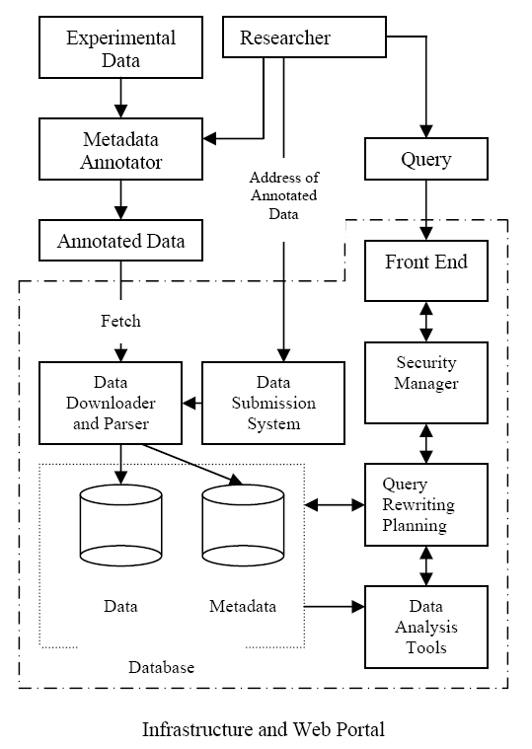
Overall Goal (cont.)
Two-part approach:
  Annotation application for semi-automatic creation of annotations
  Web-portal for searchable storage of annotated scientific data.

Slide 7
Contributions of the Paper
Propose architecture for semantically capable collaborative infrastructure for data collection and sharing
System that utilizes two-level metadata scheme for document description and dataset attributes
Description of current implementation

Slide 8
Dataset Metadata
Dublin Core (http://dublincore.org) is a set of 15 elements for minimal resource description to ensure minimal operability
  OAI-PMH
  IETF RFC 5013
  ANSI/NISO Standard Z39.85-2007
  ISO Standard 15836:2009
Attributes listed on next 3 slides

Slide 9
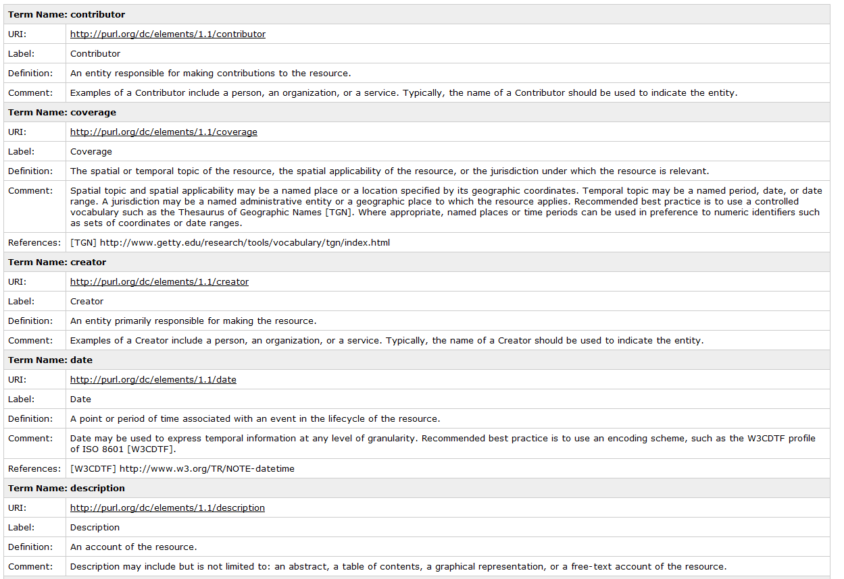

Slide 10
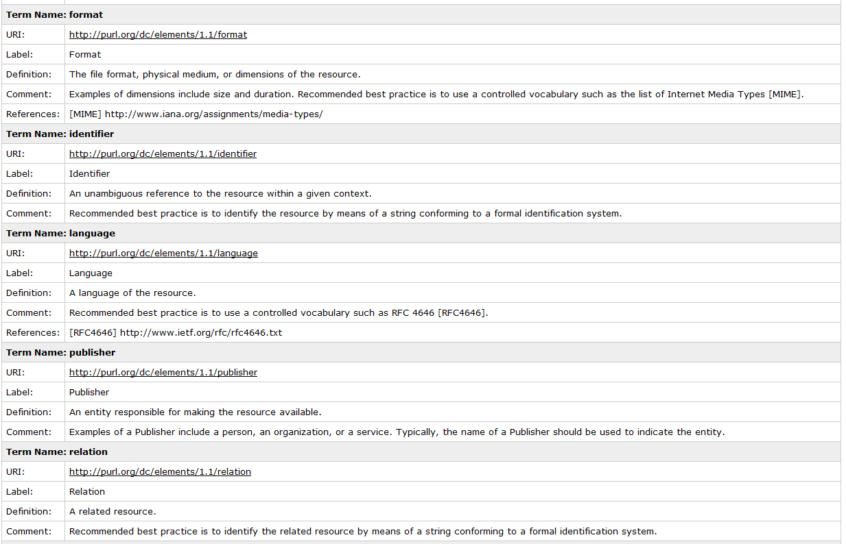

Slide 11
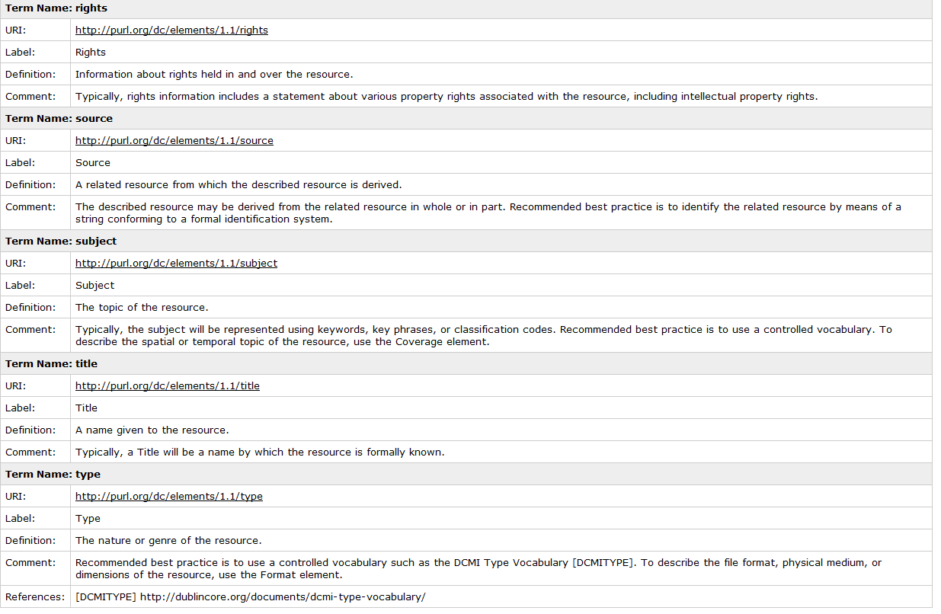

Slide 12
Dataset Metadata
Paper states “uses Dublin Core 15 elements” but actually uses the following 15:
  Title
  Creator
  Subject
  Description
  Contributor
  Publisher
  Date
  Type
  Format
  Identifier
  Source
  Relation
  References
  Is referenced by
  Language
  Rights
  Coverage.

Slide 13
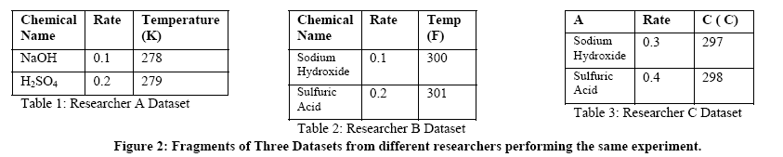
Attribute Metadata
Challenges:
  Same attribute, different row/column name
  (i.e. Temp vs Temperature
  Same row/column name, but different attribute (i.e. Temperature (in deg C) vs Temperature (in deg K)
  Row/column names may be ambiguous (i.e. Rate)

Slide 14
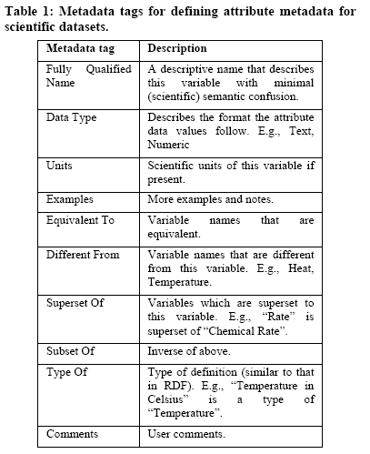
Attribute Metadata
Metadata tags for attributes (right)
Note they allow for dynamic generation of a dynamic collaboration ontology
  Equivalent To
  Different From
  Superset Of
  Subset Of
  Type Of

Slide 15
Submitting a Dataset
Uses a ``pull’’ technique
  Author submits URL
  System pulls annotated data
Pull method allows the following
  A moderator can check the URL from non-authorized submitters
  Automatic tagging of provenance information for authorized users based on URL
  Better protection from DOS attacks
    Banning of malicious users
    Implement a round-robin policy for fetching

Slide 16
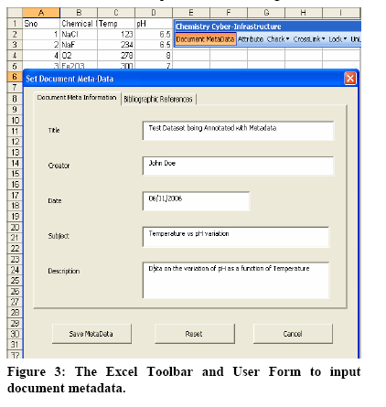
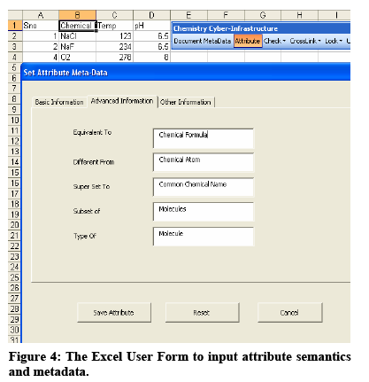
Implementation: Metadata
Used for chemical kinetics experiments
Experimental results in MS Excel
Metadata added through a MS Excel add-in

Slide 17
Implementation: Web Portal
Three components
  Web portal front-end
  Data downloader and parser
  Data analysis toolkit

Slide 18
Implementation: Web Portal
Web Portal Front-End
  Content management system
  Dataset viewer
  Data submission system
Uses Mambo Server (open source, PHP-based) content-management system
Data submission system deployed using JSP on ApacheTomcat 5

Slide 19
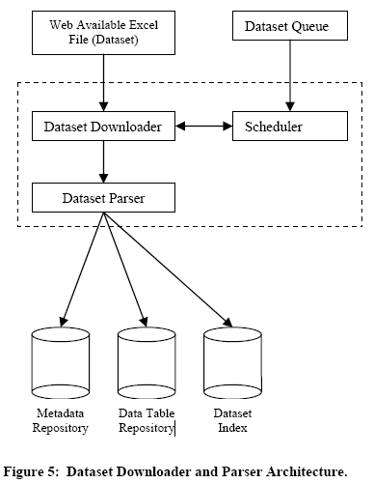
Implementation: Web Portal
Data downloader and parser
  Scheduler
  Downloader
  Parser
Parser
  Creates metadata as XML files
  Data in Excel files imported into MySQL database
  Parser creates a dataset index, linking dataset with dataset metadata and attribute metadata with data tables

Slide 20
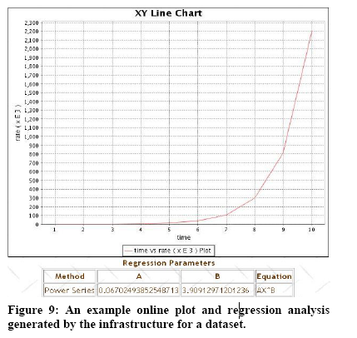
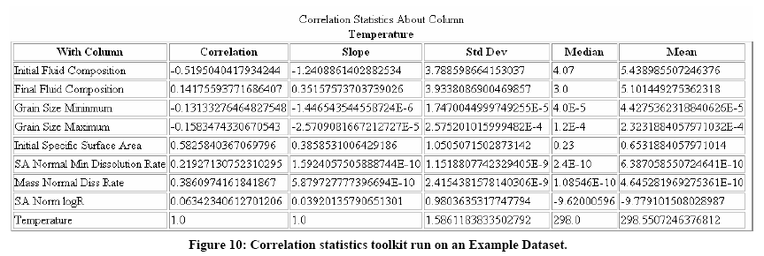
Implementation: Data Analysis Tools
In addition to supporting queries, plotting and regression tools included in web portal

Slide 21
Future Work
Develop algorithms to derive dynamic collaboration ontology's
Integrating query re-wrting and semantic searching using attribute-level semantics
Automatic metadata generation using a user’s previous experiments
Group, trust, privacy mechanisms

Slide 22
Comparison to SIBDATA Concept
Relies on central repository (as opposed to multiple repositories for SIBDATA)
Only useful for Excel-formatted experimental results
Annotations may be an interesting feature to include in a SIBDATA or CDATA.

Slide 23
Questions

